Slide 1

Bank Loan Prediction
Group Member
Clnton Idehen
Joey Z
Yichao Li
Simon Gomes

Slide 2
Motivation (add some facts, make it more nice with numbers from Australia)
In today's rapidly evolving financial landscape, lending institutions face the challenge of making informed decisions while managing risks. One of the critical aspects of this process is predicting whether a loan applicant is likely to default on their loan or repay it as agreed. To address this challenge, financial institutions are increasingly turning to machine learning, a powerful tool that can analyze vast amounts of data to provide predictive insights.
In this presentation, we will explore into the fascinating world of machine learning and its applications in the banking sector. Specifically, we will focus on how machine learning algorithms can be employed to predict the likelihood of loan applicants defaulting on their loans. This topic is of utmost importance to banks and other financial institutions as it can help them mitigate risks, streamline the lending process, and ensure the sustainability of their operations.

Slide 3


(Make if funny and nice)
This is Bob
Bob wants to buy his first house for himself and his family.
Bob works very hard and applies for a loan from the banks.
Bob successfully buys the house and will spend 30 years of his life paying off the loan.
Be like Bob

Slide 4
Dataset
The Universal Bank Loan Classification dataset is accessible to the public through Kaggle. It comprises 5,000 instances and encompasses 14 distinct attributes.
These attributes represent user information assessed across multiple criteria, including income, age, and experience.
Notably, the dataset's response variable is the 'Personal Loan' feature, which is binary in nature. A value of 0 indicates a declined loan application, while a value of 1 indicates an approved application.
The objective is to classify an instance in either of those categories – 0 or 1 (approved or not approved) based on the rest of the explanatory variables.

Slide 5

Dataset
ID: Customer ID
Age: Customer Age
Experience: Amount of work experience in years
Income: Amount of annual income (in thousands)
Zipcode: Zipcode of where customer lives
Family: Number of family members
CCAvg: Average monthly credit card spendings
Education: Education level (1: Bachelor, 2: Master, 3: Advanced Degree)
Mortgage: Mortgage of house (in thousands)
Securities Account: Boolean of whether customer has a securities account
CD Account: Boolean of whether customer has Certificate of Deposit account
Online: Boolean of whether customer uses online banking
CreditCard: Does the customer use credit card issued by the bank?
Personal Loan: This is the target variable (Binary Classification Problem)

Slide 6
Machine Learning Process
Loan data from Kaggle (CSV file)
Data cleaning
Test data to find missing value
Data visualisation (Matplotlib, Seaborn, )
Data Preparation (TensorFlow, sklearn)
Building multi-layer neural network model (ANN model)
Compilation and training of deep learning model (Keras, ANN model)
Evaluating model performance (F1 score, Precision, Recall & Accuracy)

Slide 7
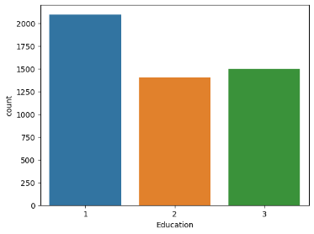
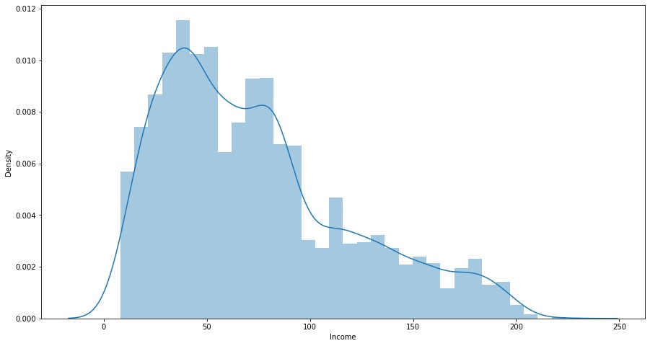
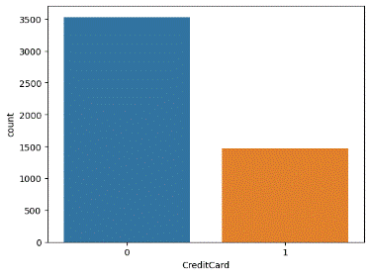
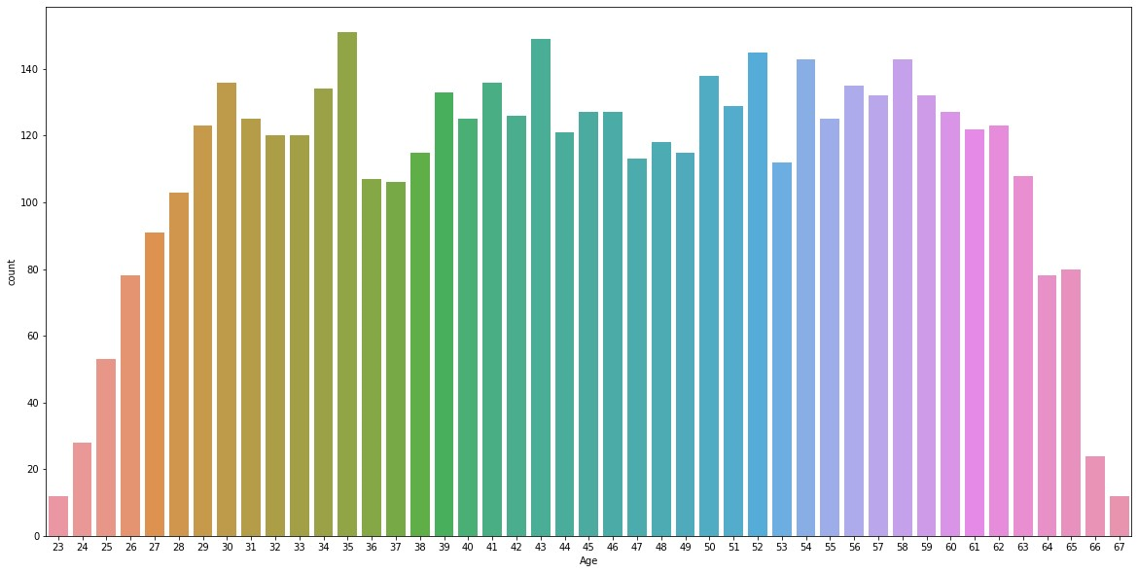
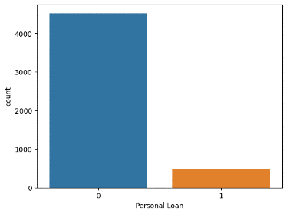
Data Visualizations (add insights)

Slide 8
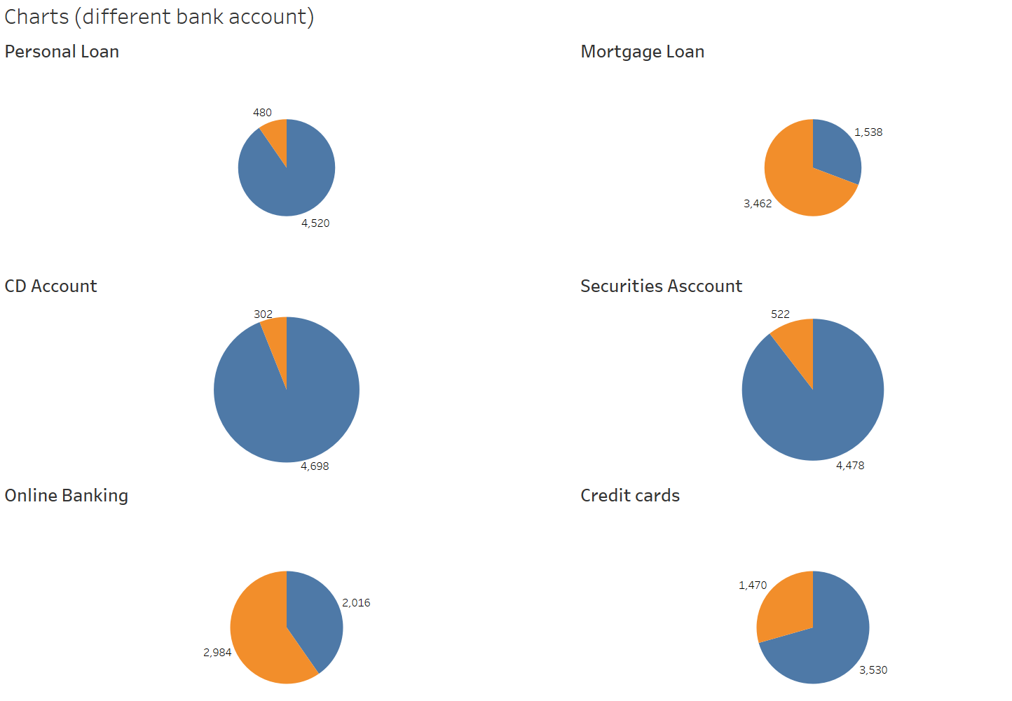
Different Bank Account (add insights and correct spelling of securities, make it in %)

Slide 9
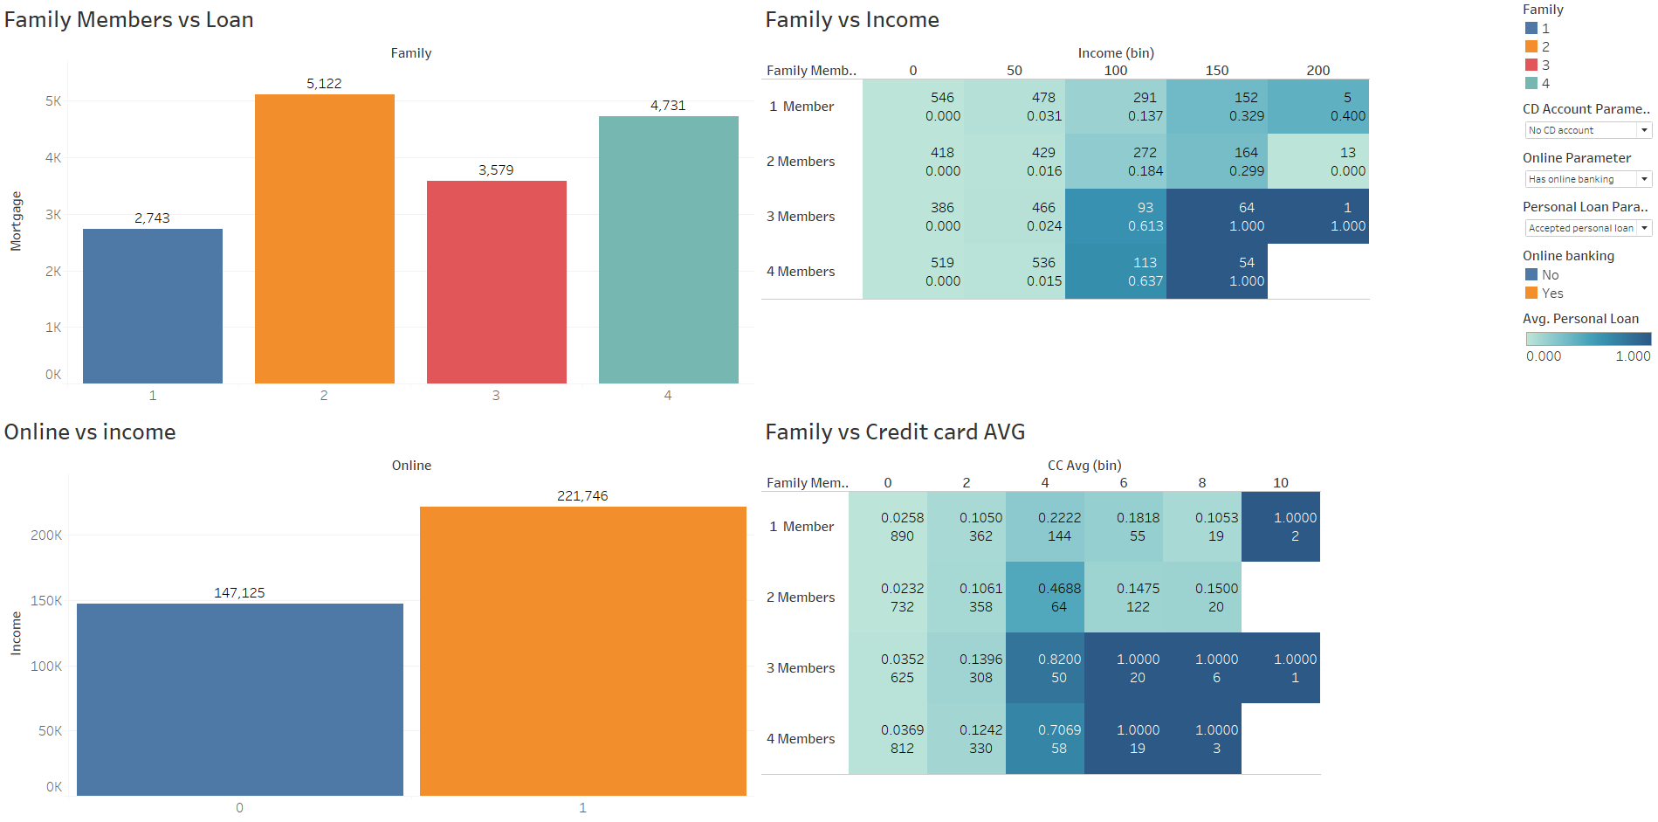
Family/Income/Consumption relationship (add insights….)

Slide 10
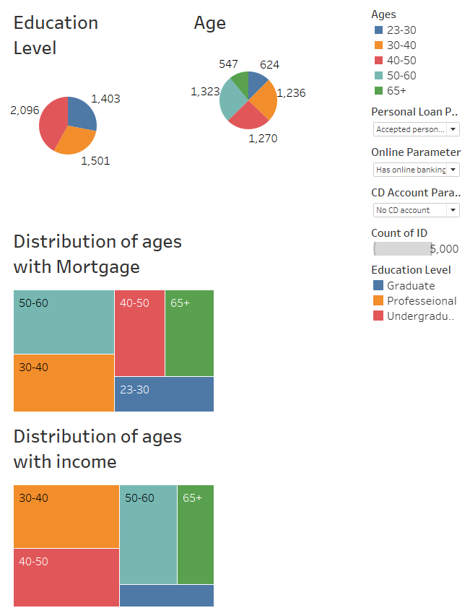
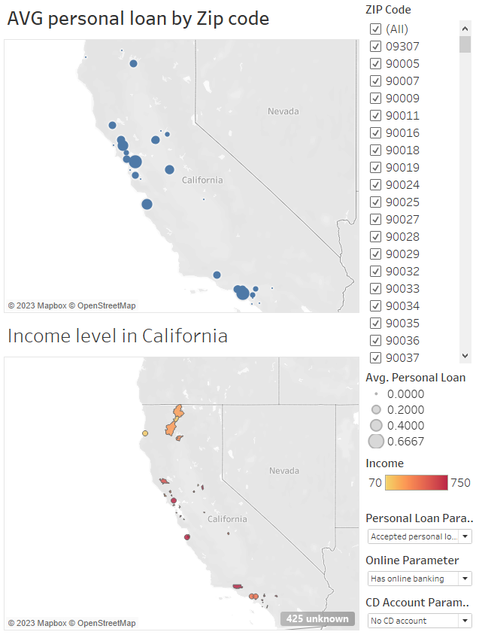
Distribution of age and income with mortgage (add insights)

Slide 11
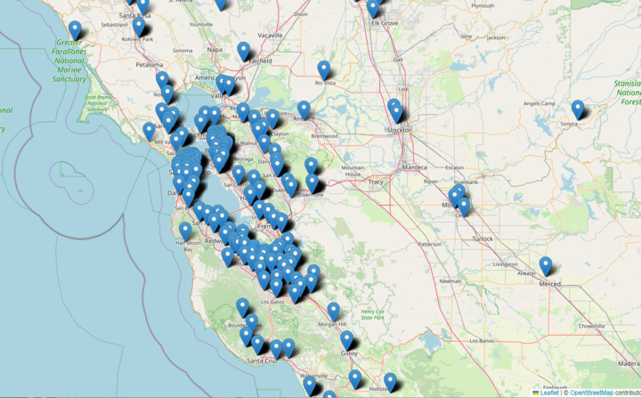
Location Map (add insights)

Slide 12
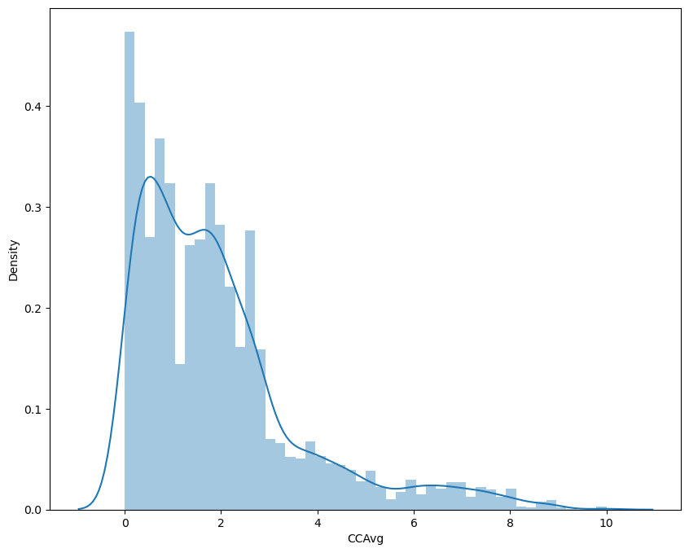
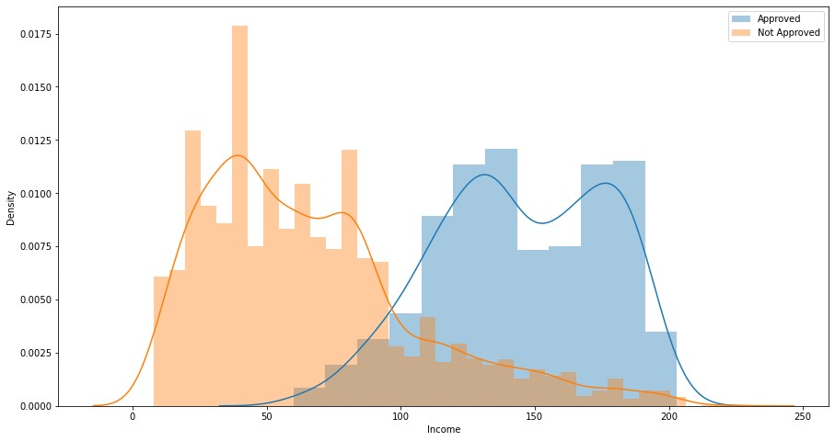
Data Visualizations (add insights)

Slide 13
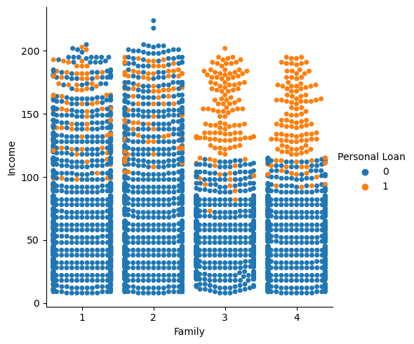
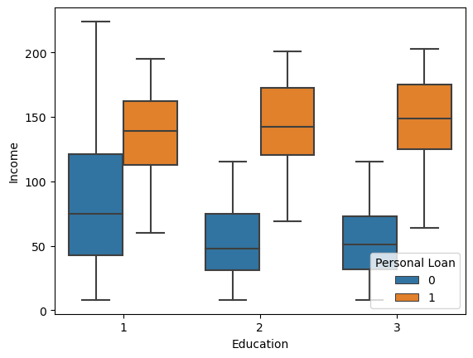
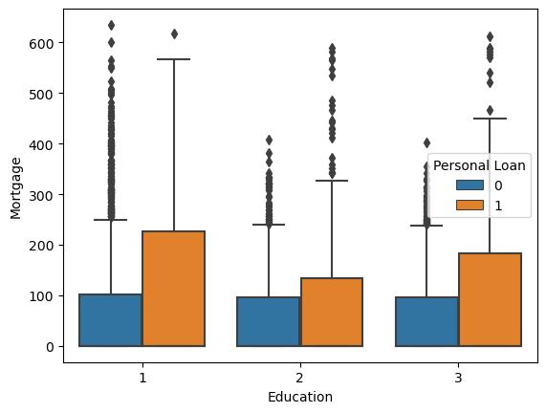
Add insights

Slide 14
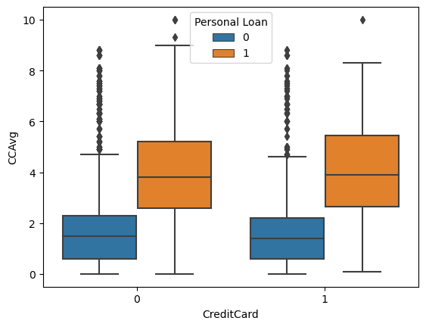
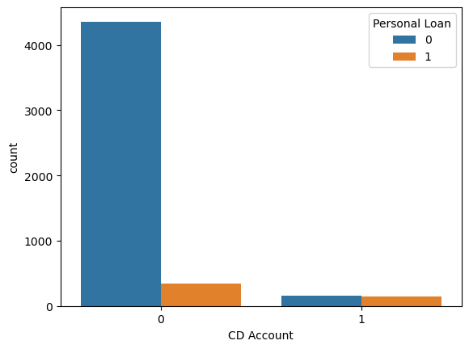
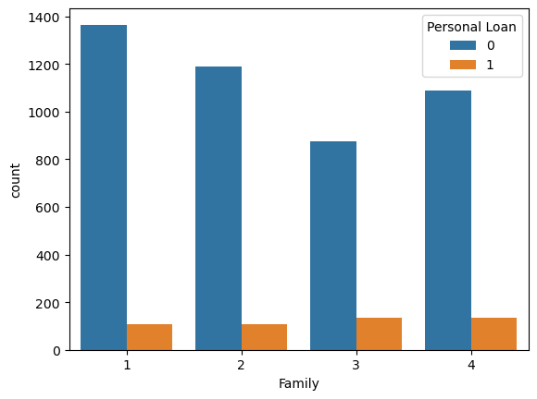
Add insights

Slide 15
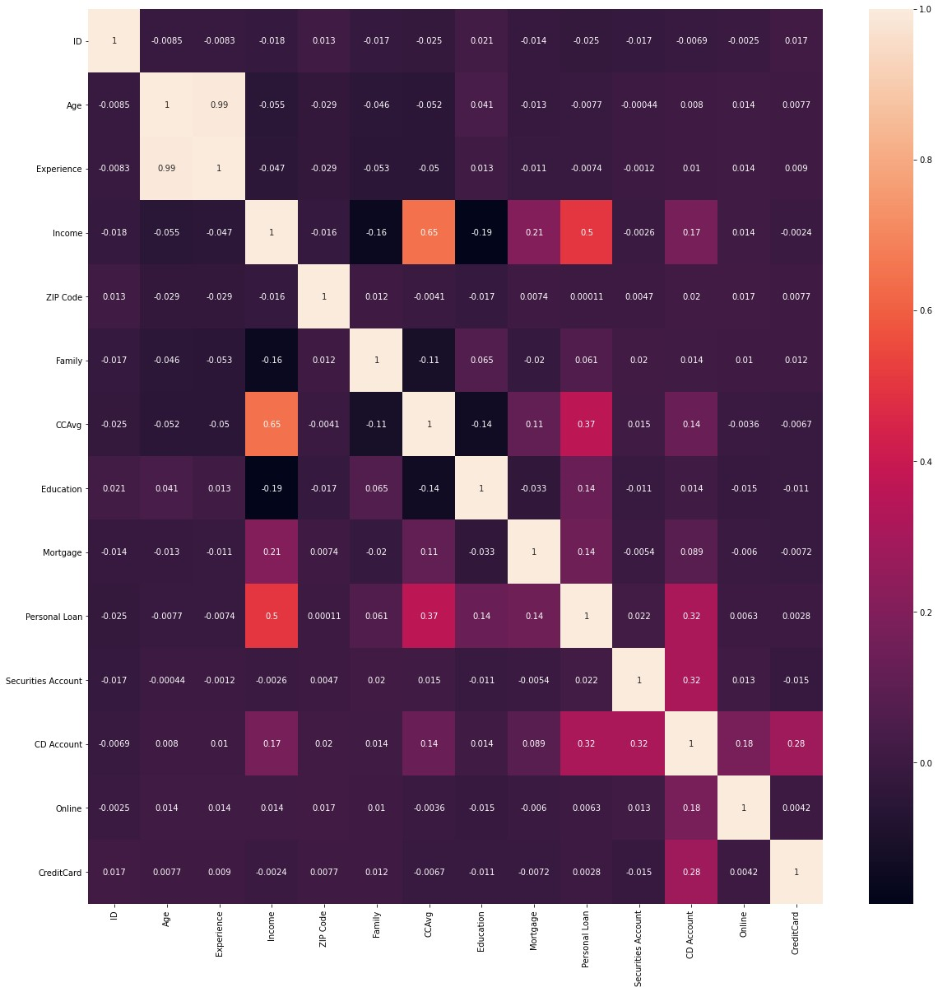
Heat map
Age and Experience are highly correlated, and the correlation is almost 1.
'Income' and 'CCAvg' is moderately correlated.
Personal Loan has maximum correlation with 'Income', 'CCAvg', 'CD Account', 'Mortgage', and 'Education'.
We can see in above heat map there is association of 'CD Account' with 'Credit Card', 'Securities Account', 'Online', 'CCAvg' and 'Income'.
'Mortgage' has moderate correlation with 'Income' which is about 12%.
'Income' influences 'CCAvg', 'Personal Loan', 'CD Account' and 'Mortgage'.

Slide 16
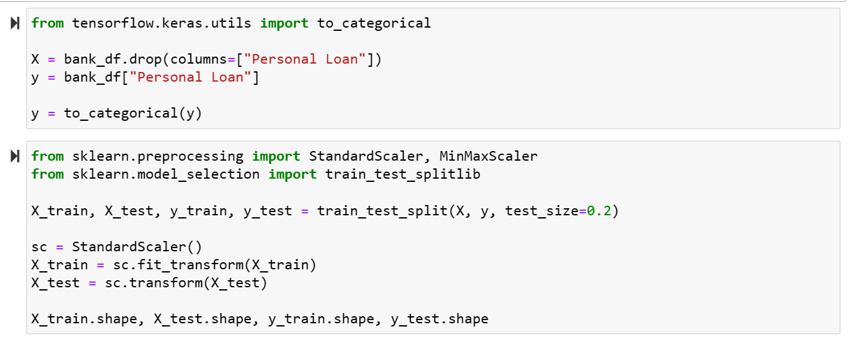
Data Preparation
To kick things off, we converted our binary target column 'Personal Loan' into a categorical variable, resulting in two distinct categories: 'Approved' and 'Not Approved.’
Following that, we'll perform a random split of our dataset into two portions: 80% allocated for training and 20% for testing. Moreover, within the training data, we'll further partition it, reserving 20% for cross-validation purposes.
Lastly, we will standardize all our features, ensuring they undergo appropriate preprocessing to enable the neural network to assign the correct weightage. Additionally, it's worth noting that we utilized TensorFlow, an open-source framework developed by Google researchers, to execute tasks such as running machine learning, deep learning, and various statistical and predictive analytics workloads.

Slide 17
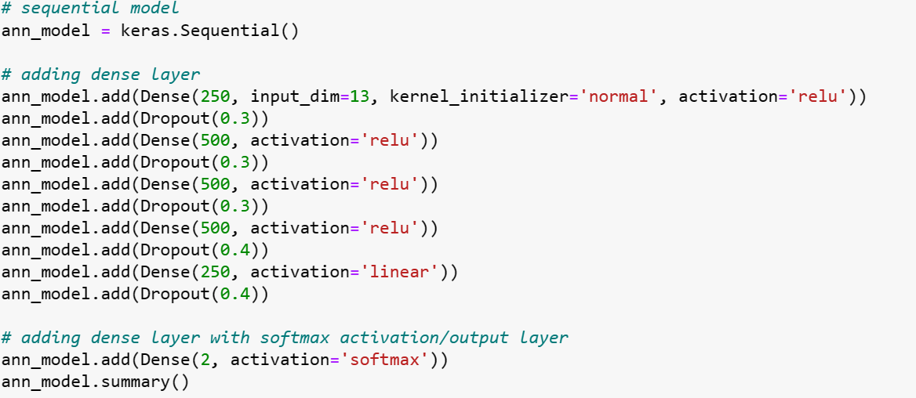
Building Multi-layer Neural Network
An artificial neural network (ANN) model is a numerical model that has the capability to approximate arbitrary continuous and bounded nonlinear functions with extensive applicability and high accuracy.
At that point, we began by assigning all the features as input. Next, we added some hidden layers to the model and then finished it off with the final target variable. The model in Keras is considered as a sequence of layers and each of them gradually “distills” the input data to obtain the desired output.
There were a total of 755,752 trainable parameters once the NN was set up.

Slide 18
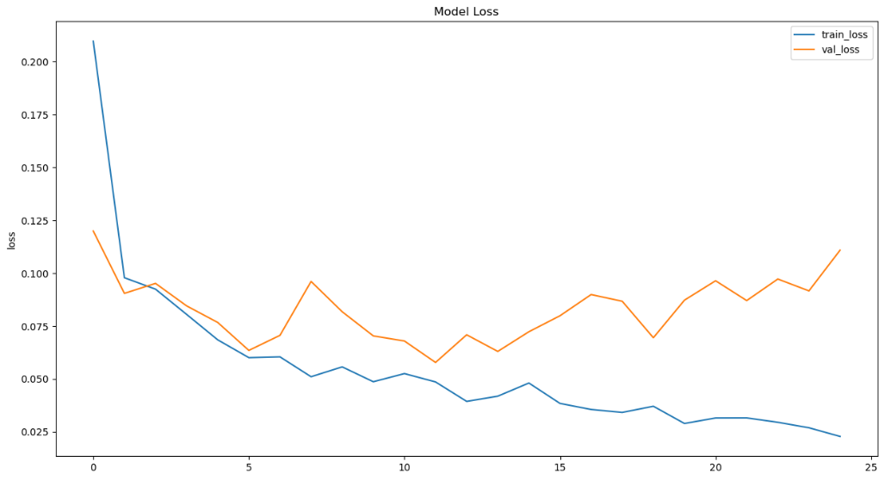
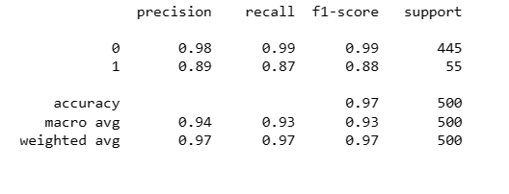
Implementation and Result
We fitted our model to our training data and there was a plot depicting the Model Loss vs. Epoch for this model.
After training and cross validation, we use our model on the testing set to predict the outcome. One more thing to note is that the model is trained for the 'f1' metrics as the dataset is highly unbalanced. It would be unwise to use accuracy metrics.
Below, we displayed the confusion matrix obtained from the final model. We can clearly see that k-Nearest Neighbors Algorithm with scaled data gives us best accuracy of 97%

Slide 19
Limitations
The Universal Bank dataset is a popular dataset often used for data analysis and machine learning, especially for tasks like predicting whether a customer will take out a personal loan. While it's a useful dataset, it does have some limitations that can affect its applicability and the accuracy of predictive models built with it. Here are some common limitations:
1. Data Imbalance: One of the significant limitations is class imbalance in the target variable, which is whether a customer accepts a personal loan or not. In many real-world scenarios, personal loan acceptance rates are low, leading to an imbalanced dataset. This imbalance can make it challenging to build accurate predictive models.
2. Small Dataset Size: The Universal Bank dataset may be relatively small, which can limit the complexity and performance of machine learning models. Smaller datasets may result in overfitting, where the model performs well on the training data but poorly on new, unseen data.
3. **Data Quality**: The quality of the data can impact the performance of predictive models. If the dataset contains missing values, outliers, or inaccuracies, it can lead to biased or less reliable predictions.
4. **Limited Features**: The dataset contains a limited number of features, which may not capture all the relevant factors influencing a customer's decision to take out a personal loan. In real-world scenarios, there are likely more variables at play.
5. **Static Data**: The dataset represents a snapshot of customer information at a single point in time. It doesn't capture changes in customer behavior or circumstances over time, which can be essential for understanding loan acceptance trends.
6. **Lack of Context**: The dataset may lack contextual information, such as economic conditions, market trends, or external factors that could influence personal loan decisions. Incorporating external data sources can provide a more comprehensive view.
7. **Assumed Data Distribution**: Many machine learning algorithms assume that the data follows a specific distribution (e.g., normal distribution). If the Universal Bank dataset doesn't meet these assumptions, it may affect the performance of some algorithms.
8. **Ethical Considerations**: When using the dataset for modeling, it's essential to consider ethical and fairness issues. Biases in the data, if not addressed, can lead to biased or unfair predictions, particularly when making decisions related to financial services.
9. **Temporal Limitations**: Since the dataset is static, it doesn't capture temporal trends or seasonality in personal loan acceptance. In reality, customer behavior and loan acceptance rates can change over time.
10. **Privacy Concerns**: Depending on how the dataset was collected and whether it contains any personally identifiable information (PII), there may be privacy and regulatory concerns when working with it.
Despite these limitations, the Universal Bank dataset can still be a valuable resource for learning and practicing data analysis and machine learning techniques. However, it's important to be aware of these limitations and consider them when interpreting the results of any analysis or predictive modeling efforts based on the dataset. In practice, additional data sources and more comprehensive feature engineering may be needed to build robust predictive models for personal loan acceptance.

